Slide 1
The Preterit Tense -ER/-IR
Señor Jackson

Slide 2
Let’s Recap!
Tell your table partner the endings for –AR Verbs
Now, stomp the Irregular Endings for the “Yo” form!!

Slide 3
-ER/-IR Verbs in Preterit Tense
Verbs that end in –ER and –IR take the same endings in the preterit tense.
Í imos
iste isteis
ió ieron

Slide 4
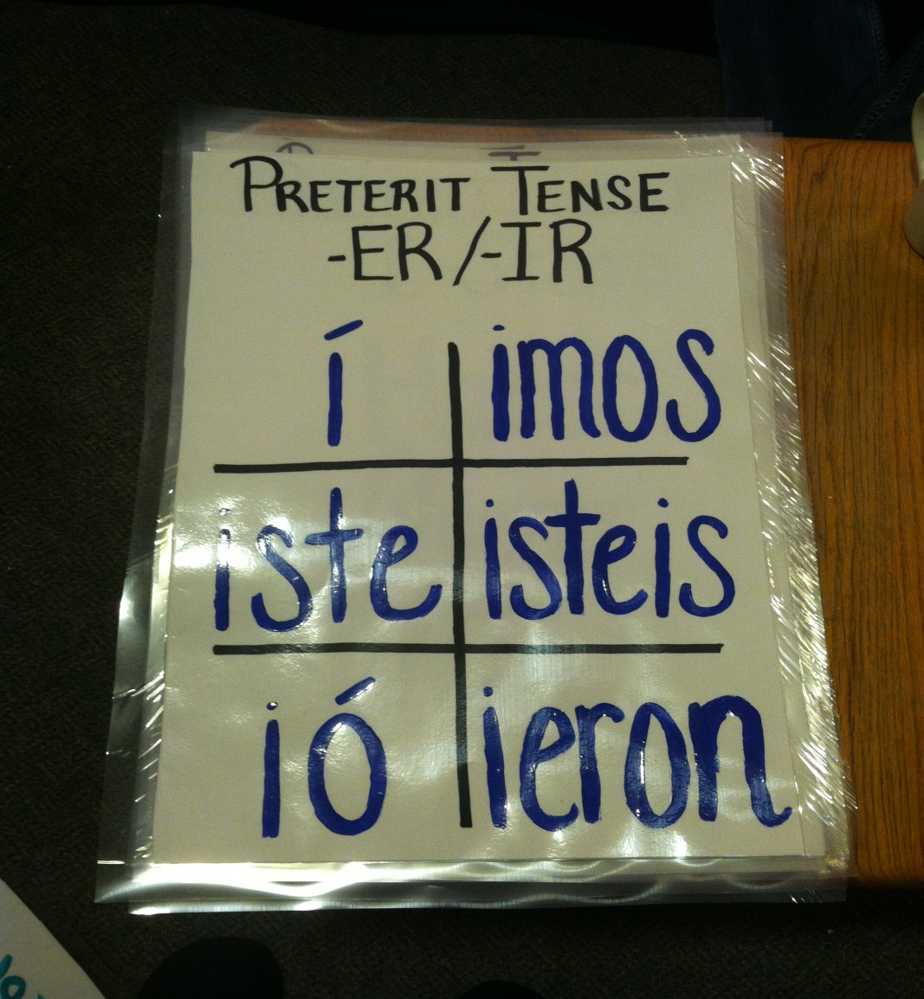

Slide 5
Let’s Practice Together
Vender

Slide 6
You and your table partner
Comer

Slide 7
You Alone
Subir

